Slide 1
Cs 329e: final project
Suliman sharif | Vincent Hochstein | Dana nelson

Slide 2
Option b: swift interpreter
Closures
List Comprehension
Lambda Expressions
Stream Operations

Slide 3
option b…ish
There is no eval function for our code.
Evaluation of the code gets done in YACC and outputs the result

Slide 4
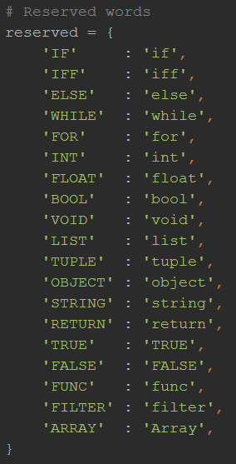
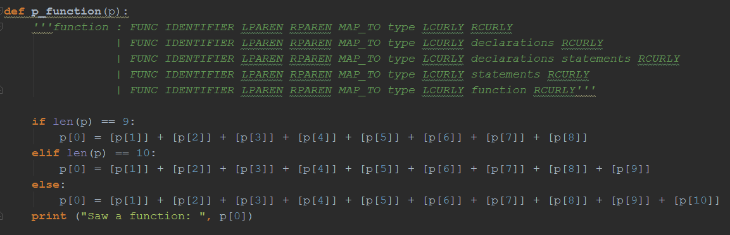
closure
1) lex.py
2) yacc.py

Slide 5
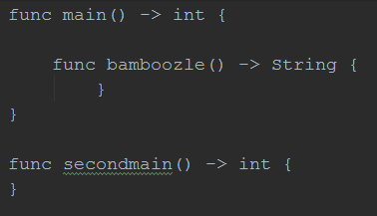
Closure Demo

Slide 6
Closure demo ast
LINE 37: function
LINE 33: function
LINE 95: type
LINE 100: type
func
main
(
)
->
int
{
func
bam
(
)
->
String
{
}
}
reserved
token
token
reserved
token
token
token
identifier
token
token
identifier
token
reserved
token
token
reserved

Slide 7
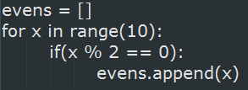
List comprehension
List of all integers between 0 and 9 that are even
PYTHON: Normal
PYTHON: List Comprehension
SWIFT: List Comprehension

Slide 8
List comprehension
Swift Syntax:
Altered Swift Syntax:

Slide 9
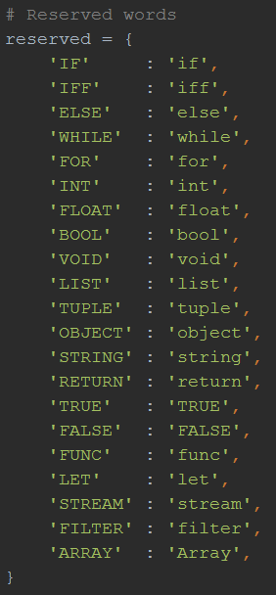
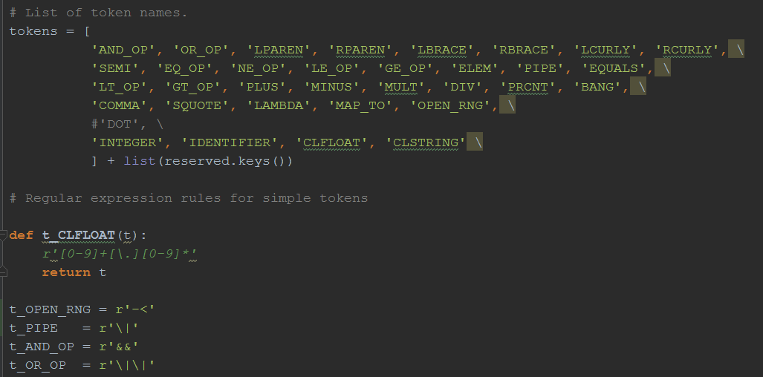
List comprehension
1) lex.py

Slide 10
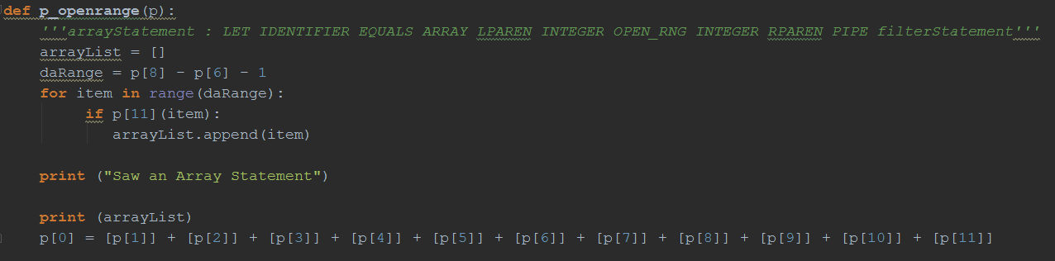
List comprehension
Yacc.py line 163:

Slide 11
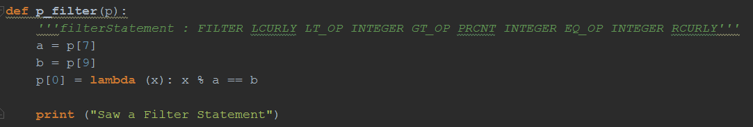
Lambda expression
filterStatement
Yacc.py line 137

Slide 12
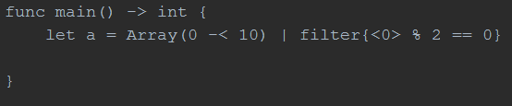
List comprehension demo

Slide 13
List comprehension demo ast
LINE 65: statement
LINE 117: arrayStatement
LINE 92: filterStatement
let
a
=
Array
(
0
-<
10
)
|
filter
{
<
0
>
%
2
==
0
}
reserved
token
token
integer
token
integer
identifier
token
reserved
reserved
integer
token
token
token
token
token
integer
integer
token
token

Slide 14
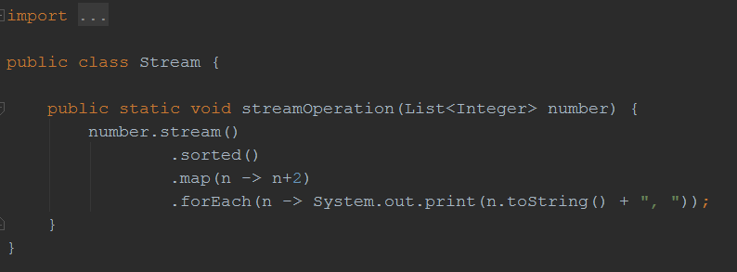
Stream operations
Stream.java
streamOperation method accepts a list of integers as an argument
Streams → sorts low to high → adds 2 to each element → prints each element

Slide 15
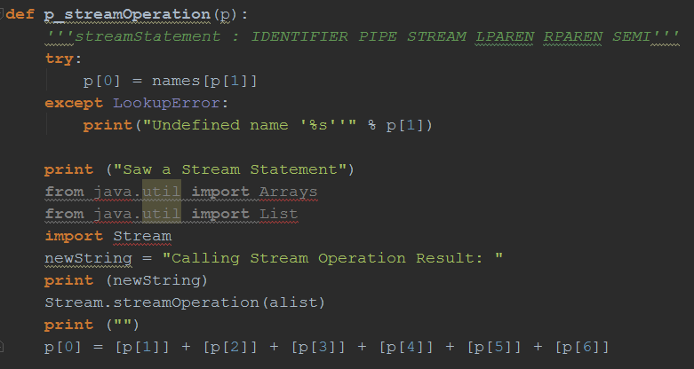
Stream operations
Yacc.py line 146
Imports necessary java items
Calls Stream.streamOperation on the list

Slide 16
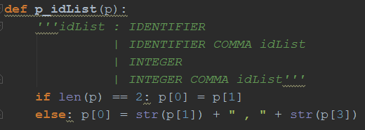
Stream operations
Yacc.py line 77: builds a list

Slide 17
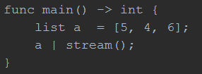
Stream operations demo

Slide 18
Stream operations demo ast
Line 104: statements
LINE 65: statement
Line 105: statements
LINE 47: listStatement
LINE 81: idList
LINE 65: statement
LINE 81: idList
LINE 146: streamStatement
LINE 80: idList
list
a
=
[
5
,
4
,
6
]
;
a
|
stream
(
)
;
reserved
token
identifier
token
token
reserved
token
integer
integer
token
token
token
token
integer
token
token
identifier

Slide 19
Bugs / Things to fix
Cannot implement Swift ‘.’ ..< or $ operators. Returns a syntax Error
Less specific grammar rules
Implement eval function / set up environment

Slide 20
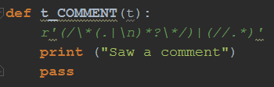
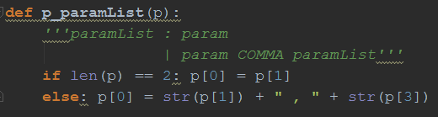
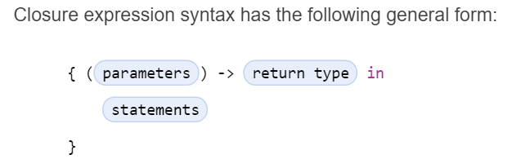
extras
Swifty comments (lex.py line 86)
Swifty closure expression AKA lambda (yacc.py line 85)

Slide 21
Thank you!

